Slide 1
changing your life forever

Slide 2
changing your life forever

Slide 3
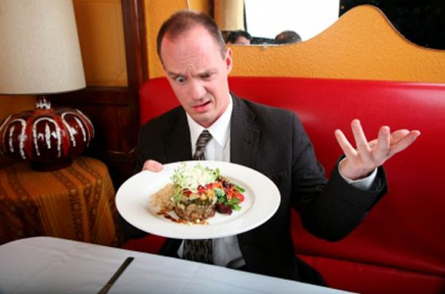

Slide 5
Understand situation, not quit.
Learn to leave results up to God.
Won’t be selective in who we serve.
Each is opportunity to honor God.
Know enough when to say, “yes” “no.”
Attitudes will vastly improve.
Learn to love biblically.
Live sacrificially.

Slide 7
#1 It’s not a contradiction: Greatness means exercising servanthood, not power.
Matthew 20:25-28

Slide 8
Matthew 20:25-28 Jesus called them together and said, "You know that the rulers of the Gentiles lord it over them, and their high officials exercise authority over them. 26 Not so with you. Instead, whoever wants to become great among you must be your servant, 27 and whoever wants to be first must be your slave-- 28 just as the Son of Man did not come to be served, but to serve, and to give his life as a ransom for many."

Slide 9
#1 It’s not a contradiction: Greatness means exercising servanthood, not power.
Jesus would have us pursue the role of servanthood, not power.

Slide 10
#2 It’s not a contradiction:
Greatness and leadership are known by servanthood, not rank.
Luke 22:24-28

Slide 11
Luke 22:24-28 Also a dispute arose among them as to which of them was considered to be greatest. 25 Jesus said to them, "The kings of the Gentiles lord it over them; and those who exercise authority over them call themselves Benefactors. 26 But you are not to be like that. Instead, the greatest among you should be like the youngest, and the one who rules like the one who serves. 27 For who is greater, the one who is at the table or the one who serves? Is it not the one who is at the table? But I am among you as one who serves. 28 You are those who have stood by me in my trials.

Slide 12
#2 It’s not a contradiction:
Greatness and leadership are known by servanthood, not rank.
Jesus would have us pursue
the role of servanthood,
not rank.

Slide 13
#3 It’s not a contradiction:
Greatness means doing the things servants do.
John 13:1-17

Slide 14
John 13:1-17 It was just before the Passover Feast. Jesus knew that the time had come for him to leave this world and go to the Father. Having loved his own who were in the world, he now showed them the full extent of his love. 2 The evening meal was being served, and the devil had already prompted Judas Iscariot, son of Simon, to betray Jesus. … 4 so he got up from the meal, took off his outer clothing, and wrapped a towel around his waist.

Slide 15
5 After that, he poured water into a basin and began to wash his disciples' feet, drying them with the towel that was wrapped around him. … 11 For he knew who was going to betray him, and that was why he said not everyone was clean. 12 When he had finished washing their feet, he put on his clothes and returned to his place. "Do you understand what I have done for you?" he asked them. 13 "You call me 'Teacher' and 'Lord,' and rightly so, for that is what I am.

Slide 16
14 Now that I, your Lord and Teacher, have washed your feet, you also should wash one another's feet. 15 I have set you an example that you should do as I have done for you. 16 I tell you the truth, no servant is greater than his master, nor is a messenger greater than the one who sent him. 17 Now that you know these things, you will be blessed if you do them.

Slide 17
Physical act defines the spiritual.
Jesus even served his enemy, Judas.
Jesus really loved people.

Slide 18
we won’t be waiting on others to come around and serve us, but rather we will take the initiative.
we will stop evaluating if someone is worthy of us serving them.
we are learning how to love unconditionally, with no strings attached.

Slide 19
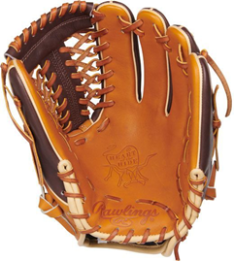

Slide 21
Philippians 2:1-11 If you have any encouragement from being united with Christ, if any comfort from his love, if any fellowship with the Spirit, if any tenderness and compassion, 2 then make my joy complete by being like-minded, having the same love, being one in spirit and purpose. 3 Do nothing out of selfish ambition or vain conceit, but in humility consider others better than yourselves. 4 Each of you should look not only to your own interests, but also to the interests of others.

Slide 22
5 Your attitude should be the same as that of Christ Jesus: 6 Who, being in very nature God, did not consider equality with God something to be grasped, 7 but made himself nothing, taking the very nature of a servant, being made in human likeness. 8 And being found in appearance as a man, he humbled himself and became obedient to death-- even death on a cross!

Slide 23
9 Therefore God exalted him to the highest place and gave him the name that is above every name, 10 that at the name of Jesus every knee should bow, in heaven and on earth and under the earth, 11 and every tongue confess that Jesus Christ is Lord, to the glory of God the Father.

Slide 25
Our attitudes will either make us servants or keep us from changing the rest of our lives being servants.

Slide 26
The attitude of Christ can keeps one serving when it’s not fun or convenient any longer.
Hebrews 12:2-3 Let us fix our eyes on Jesus, the author and perfecter of our faith, who for the joy set before him endured the cross, scorning its shame, and sat down at the right hand of the throne of God. 3 Consider him who endured such opposition from sinful men, so that you will not grow weary and lose heart.

Slide 27
The attitude of Christ keeps one focused on being the presence of Christ in some of the most awkward of situations.
Matthew 25:34-40 For I was hungry and you gave me something to eat, I was thirsty and you gave me something to drink, I was a stranger and you invited me in, 36 I needed clothes and you clothed me, I was sick and you looked after me, I was in prison and you came to visit me.'

Slide 28
35 For I was hungry and you gave me something to eat, I was thirsty and you gave me something to drink, I was a stranger and you invited me in, 36 I needed clothes and you clothed me, I was sick and you looked after me, I was in prison and you came to visit me.'
... 40 "The King will reply, 'I tell you the truth, whatever you did for one of the least of these brothers of mine, you did for me.'

Slide 29
The attitude of Christ enables one to serve, regardless of the service done.
Matthew 10:42 And if anyone gives even a cup of cold water to one of these little ones because he is my disciple, I tell you the truth, he will certainly not lose his reward."

Slide 30
The attitude of Christ enables one to think of overs.
Philippians 2:21 For everyone looks out for his own interests, not those of Jesus Christ.

Slide 31
The attitude of Christ helps one remember that serving is not optional.
Matthew 25:41-45 ... "He will reply, 'I tell you the truth, whatever you did not do for one of the least of these, you did not do for me.'

Slide 32
Reminds one that he/she is replaceable and not to think more of oneself than he/she should.
Luke 19:40 "I tell you," he replied, "if they keep quiet, the stones will cry out."
.

Slide 33
Correct the false thinking that “by serving God, God will be glad, and I’ll earn some, points with God.”
Luke 17:10 So you also, when you have done everything you were told to do, should say, 'We are unworthy servants; we have only done our duty.'"

Slide 34
The attitude of Christ helps one see past the mediocrity and failures of others and to envision for them a life of service beyond what we can imagine.

Slide 36
..want to honor God? ..willing to serve even people like Judas in my life? Is honoring God what matters most?
..want to work on my attitude... maybe help to change the lives of others forever too?
...love people and if not, will I ask God to help me learn so I can honor Him and serve people?
...want to do anything about
this because Jesus is Lord?

