Slide 3
Definitive statement of who Jesus is:
John 20:30-31 Jesus did many other miraculous signs in the presence of his disciples, which are not recorded in this book. ³¹But these are written that you may believe that Jesus is the Christ, the Son of God, and that by believing you may have life in his name.

Slide 4
Matthew 16:13-15 When Jesus came to the region of Caesarea Philippi, he asked his disciples, "Who do people say the Son of Man is?" ¹⁴They replied, "Some say John the Baptist; others say Elijah; and still others, Jeremiah or one of the prophets." ¹⁵"But what about you?" he asked. "Who do you say I am?" ¹⁶Simon Peter answered, "You are the Christ, the Son of the living God."

Slide 5
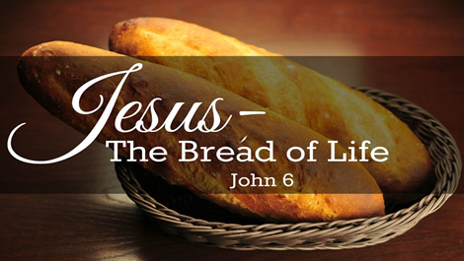
John 6:1-15 Sometime after this, Jesus crossed to the far shore of the Sea of Galilee (that is, the Sea of Tiberias), ²and a great crowd of people followed him because they saw the miraculous signs he had performed on the sick. ³Then Jesus went up on a mountainside and sat down with his disciples.

Slide 6
⁴The Jewish Passover Feast was near. ⁵When Jesus looked up and saw a great crowd coming toward him, he said to Philip, "Where shall we buy bread for these people to eat?" ⁶He asked this only to test him, for he already had in mind what he was going to do. ⁷Philip answered him, "Eight months' wages would not buy enough bread for each one to have a bite!" ⁸Another of his disciples, Andrew, Simon Peter's brother, spoke up

Slide 7
⁹"Here is a boy with five small barley loaves and two small fish, but how far will they go among so many?" ¹⁰Jesus said, "Have the people sit down." There was plenty of grass in that place, and the men sat down, about five thousand of them. ¹¹Jesus then took the loaves, gave thanks, and distributed to those who were seated as much as they wanted. He did the same with the fish.

Slide 8
¹²When they had all had enough to eat, he said to his disciples, "Gather the pieces that are left over. Let nothing be wasted." ¹³So they gathered them and filled twelve baskets with the pieces of the five barley loaves left over by those who had eaten. ¹⁴After the people saw the miraculous sign that Jesus did, they began to say, "Surely this is the Prophet who is to come into the world." ¹⁵Jesus, knowing that they intended to come and make him king by force, withdrew again to a mountain by himself.

Slide 9
how in the world did so many people wind up so far from home, not thinking about what they would eat?
this is the area where Philip was from.
5 barley loaves and 2 fish.
In a very organized fashion, Jesus has the people sit down.

Slide 10
5000 plus women/children
Not a token snack
Jesus withdrew because he knew intent of the crowd.
Questions, thought they had ‘eyes on Jesus.’

Slide 11
John 6:25-35 When they found him on the other side of the lake, they asked him, "Rabbi, when did you get here?" ²⁶Jesus answered, "I tell you the truth, you are looking for me, not because you saw miraculous signs but because you ate the loaves and had your fill. ²⁷Do not work for food that spoils, but for food that endures to eternal life, which the Son of Man will give you. On him God the Father has placed his seal of approval."

Slide 12
²⁸Then they asked him, "What must we do to do the works God requires?" ²⁹Jesus answered, "The work of God is this: to believe in the one he has sent." ³⁰So they asked him, "What miraculous sign then will you give that we may see it and believe you? What will you do? ³¹Our forefathers ate the manna in the desert; as it is written: 'He gave them bread from heaven to eat.'"

Slide 13
" ³²Jesus said to them, "I tell you the truth, it is not Moses who has given you the bread from heaven, but it is my Father who gives you the true bread from heaven. ³³For the bread of God is he who comes down from heaven and gives life to the world." ³⁴"Sir," they said, "from now on give us this bread." ³⁵Then Jesus declared, "I am the bread of life. He who comes to me will never go hungry, and he who believes in me will never be thirsty.

Slide 14
Feeding in the wilderness for 40 years.
Manna = “what is it?”
Wants to teach what they do not want to hear.
Jesus wants to teach about eternal life, they want another miracle.
Fail: physical hunger not as important as spiritual hunger.

Slide 15
John 6:48-51 I am the bread of life. ⁴⁹Your forefathers ate the manna in the desert, yet they died. ⁵⁰But here is the bread that comes down from heaven, which a man may eat and not die. ⁵¹I am the living bread that came down from heaven. If anyone eats of this bread, he will live forever. This bread is my flesh, which I will give for the life of the world."

Slide 16
“How does one then obtain this bread?”
John 6: 29
Jesus answered, "The work of God is this: to believe in the one he has sent."

Slide 18
What we need to do about that hunger; Give them the Bread of Life, Jesus.

Slide 19
People living in daily chaos.
People with lots of questions.
People living without hope.
People looking for hope someplace else.
1.73 Billion people in the world

Slide 20
They are willing to live a life of chaos,
They are willing to live with questions about life going unanswered,
They are willing to live without hope,
They are willing to look for hope elsewhere. But, we know them!
What do we do? We have the Bread of Life, we have eaten of the Bread of Life. What do we do?

Slide 21
Pray: Ask God to do what you cannot.
Pray: Seek how God can use you.
Pray: You may be the only one who cares, can do this.

Slide 22
Be Jesus.
Learn how to be “Jesus” to people.
Learn how Jesus interacted with all people, even broken, chaotic people.
Be an authentic disciple of Jesus.

Slide 23
Give the Bread of Life, Scripture
Be the Scripture people can read.
Be the answers to some questions.
As a beggar who found bread telling another beggar where to find bread.

Slide 24
Teach what faith is about.
Prioritize worship.
Demonstrate “walking by faith”
Say it, plan it, live it.

Slide 25
WHAT BREAD IS to hunger, Jesus claims to be for the soul. ... Bread can meet many needs. So can Jesus. He adapts himself to meet our needs. He has a word for the lonely as well as for the popular. He has help for the physically ill and the emotionally ill. If your vision is clear, he can help you. If your vision is cloudy, he can help you. Jesus can meet each need. Max Lucado

Slide 26
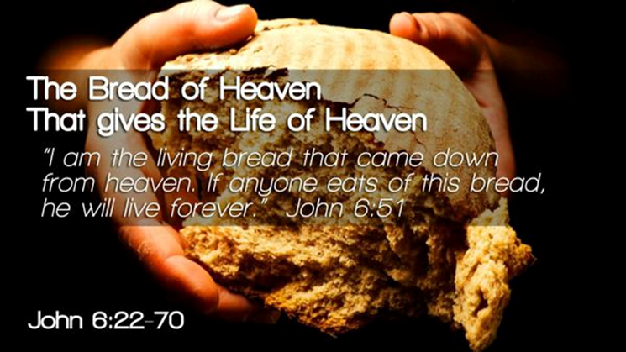
There are the hungry people in your life! Will you ignore their hunger or will you show and offer them Jesus, the Bread of Life.

